Slide 1
Indian grocery List
Shashank Shivdas
Richie Carvalho

Slide 2
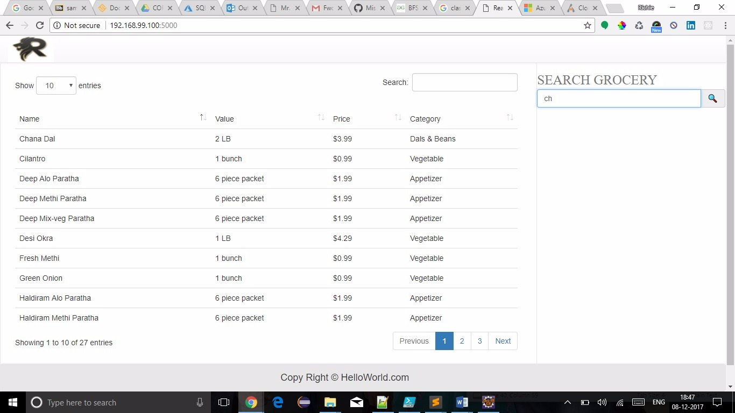
Working of The Assignment Search for an Item in the Search box:

Slide 3
Technologies Used
-Docker
-Python
- Html
-CSS
-Javascript

Slide 4
Thank You

